Slide 1
Big Mountain Resort
How to keep it profitable

Slide 2
Big Mountain Resort
Big Mountain Resort offers spectacular views of Glacier National Park and Flathead National Forest. The resort originally opened in 1947 with an annual snowfall of 333 inches and 3,000 acres of skier and rider accessible terrain. Big Mountain Resort offers access to 105 named trails and vast bowl and tree skiing. All these are serviced by 11 lifts, 2 T-bars and 1 magic carpet for novice skiers. The longest run is named Hellfire and is 3.3 miles in length. The base elevation is 4,464 feet, and the summit is 6,817 feet with a vertical drop of 2,353 feet.
With a terrain rating of 12% beginner, 38% intermediate, 44% advanced and 6% expert, this mountain can accommodate skiers and riders of all levels and abilities.

Slide 3
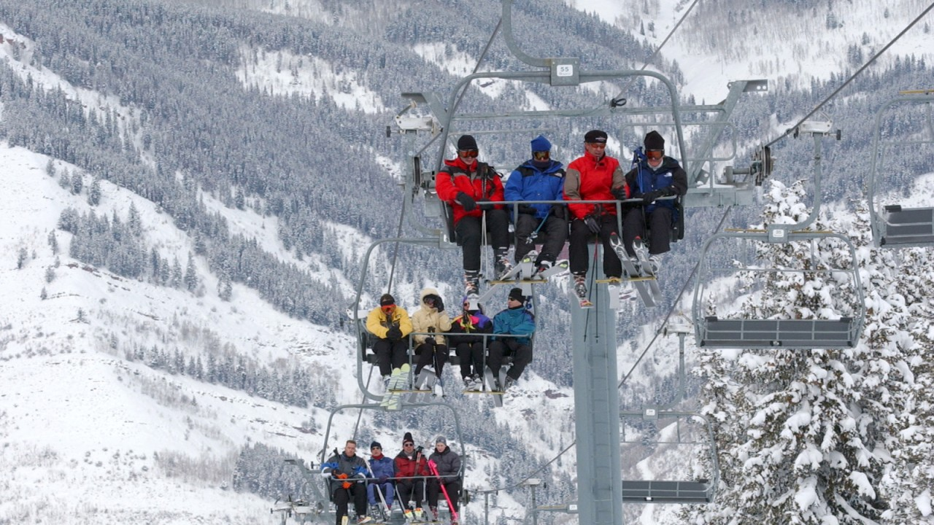
New Chair Lift
Big Mountain Resort has recently installed an additional chair lift to help increase the distribution of visitors across the mountain.
This additional chair increases their operating costs by $1,540,000 this season.
The business profit margin is 9.2% and we would like to keep it there.

Slide 4
The Competition
We have looked at a list of 330 resorts in the US that can be considered part of the same market share
The data that we were comparing included the following:
state, summit elevation, vertical drop, number of various ski lifts, total number of runs in resort, number of terrain parks, length of the longest run, total skiable area, total area covered by snow making machines, number of days open last year, number of years resort has been open, average snowfall, adult weekday and weekend chairlift ticket, projected days open in the upcoming season and finally total skiable area covered in lights for night skiing.

Slide 5
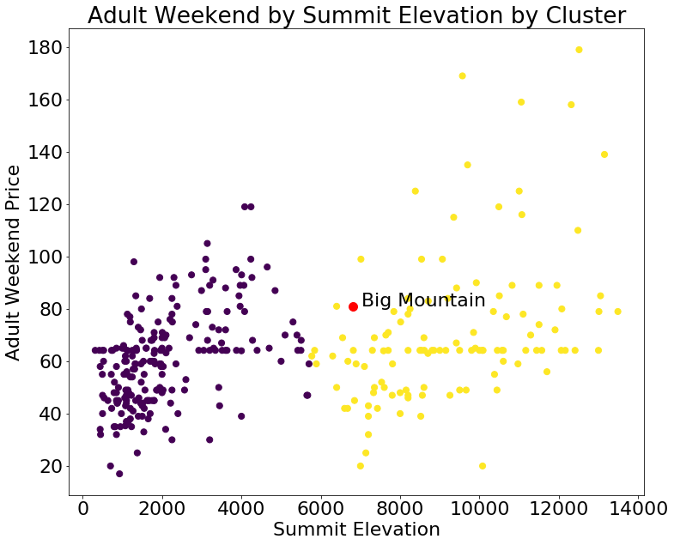
Where Do We Stand
The number I was concentrating on was the price of and adult weekend chairlift ticket. Overall study shows that this price can be safely raised to $87.60 from the current $81.

Slide 6
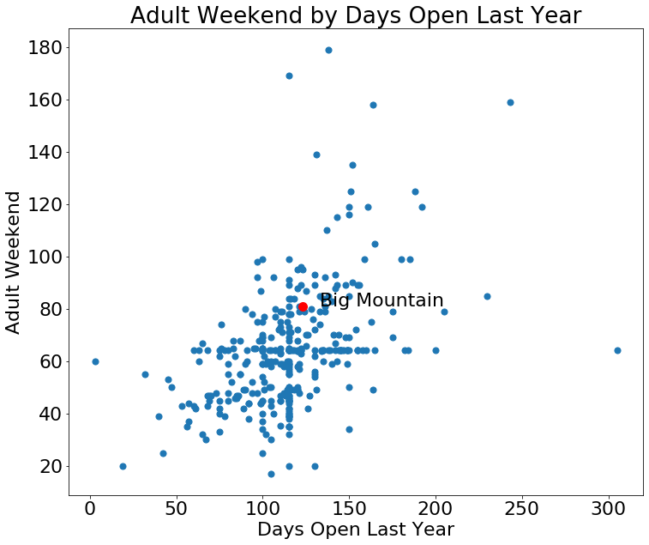
Another comparison

Slide 7
What affects the ticket price the most
Resort Features | Correlation Coefficient
Number of fast four person chairlifts | 1.212
Vertical drop | 1.166
Count of regular speed single person lifts | 1.156
Number of days open last year | 1.038
Count of regular speed three person chairlifts | 0.982
Total skiable area covered in lights for night skiing | 0.930
Count of number of runs on the resort | 0.902
Count of regular speed four person chairlifts | 0.902
Projected days open in the upcoming season | 0.678
Average annual snowfall | 0.673
Some of this things can’t be changed, but those that can will give Big Mountain competitive advantage. Clearly number of chairlifts is a big factor, so the new chairlift should give the resort competitive edge.

